Slide 1
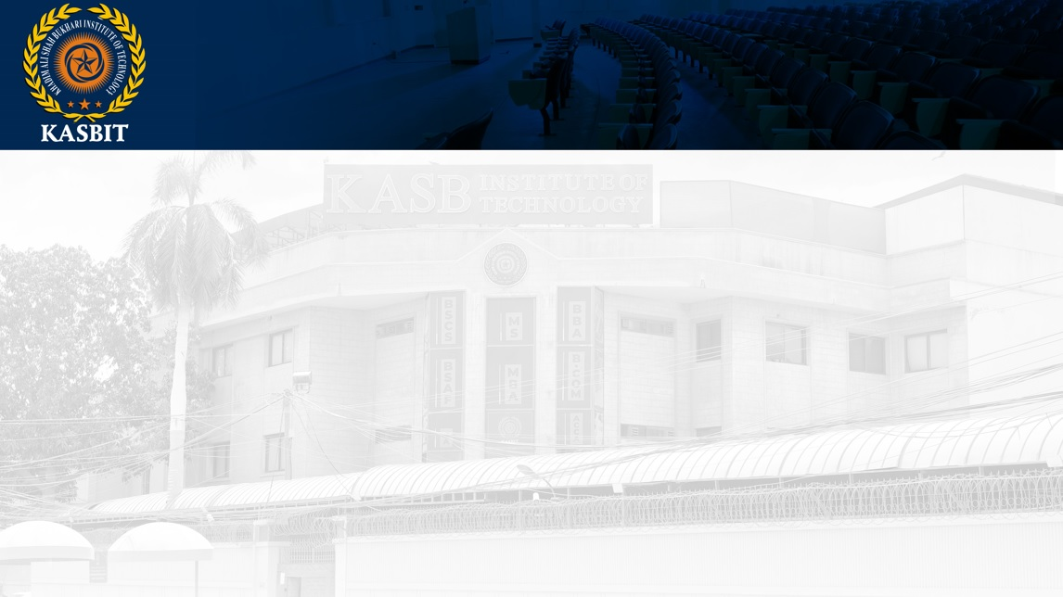
Fundamentals of Management
SESSION 9
BY
Azar Ejaz Ateeq

Slide 2
Chapter 5
Organization Design

Slide 3
Contingency Factors
Strategy and Structure
Size and Structure
Technology and Structure
Environmental Uncertainty and Structure
Reference: Management, 14th Edition by Stephen P. Robbins

Slide 4
Strategy and Structure
Achievement of strategic goals is facilitated by changes in organizational structure that accommodate and support change.
Size and Structure
As an organization grows larger, its structure tends to change from organic to mechanistic with increased specialization, departmentalization, centralization, and rules and regulations. Large organizations tend to have more specialization, departmentalization, centralization, and regulations than small organizations.
Reference: Management, 14th Edition by Stephen P. Robbins

Slide 5
Technology and Structure
Organizations adapt their structures to their technology.
Environmental Uncertainty and Structure
Mechanistic organizational structures tend to be most effective in stable and simple environments.
Reference: Management, 14th Edition by Stephen P. Robbins

Slide 6
Common Organizational Designs
Traditional Organizational Designs
Contemporary Organizational Designs
Reference: Management, 14th Edition by Stephen P. Robbins

Slide 7
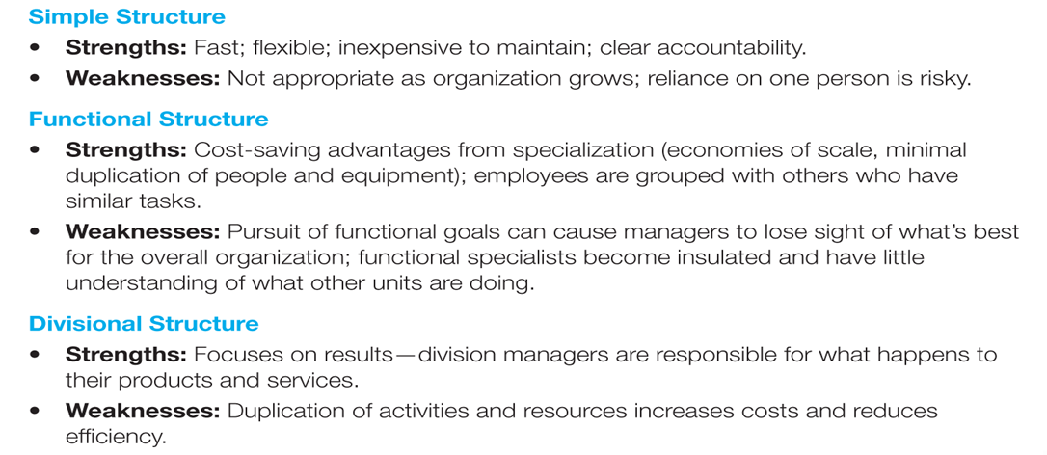
Traditional Organizational Designs
Reference: Management, 14th Edition by Stephen P. Robbins
Notes:
In making structural decisions, managers can choose either a traditional or contemporary design.
Within traditional organizational design, there are three structures: simple, functional, and divisional, all of which tend to be mechanistic in nature. Here in Exhibit 6-9 we see a summary of the strengths and weaknesses of each.
Since most companies start as entrepreneurial ventures, they use a simple structure, which is an organizational design with low departmentalization, wide spans of control, authority centralized in a single person, and little formalization.
The simple structure is most widely used in smaller businesses and it’s fast, flexible, inexpensive to maintain, and has clear accountability. However, as an organization grows, there are few policies to guide operations, which creates information overload at the top and slows decision making.
As employees are added, most small businesses tend to become more specialized and formalized. Rules and regulations are introduced, work becomes specialized, departments are created, levels of management are added, and the organization becomes increasingly bureaucratic.
Two of the most popular bureaucratic design options grew out of functional and product departmentalizations. They are called the functional and divisional structures.

Slide 8
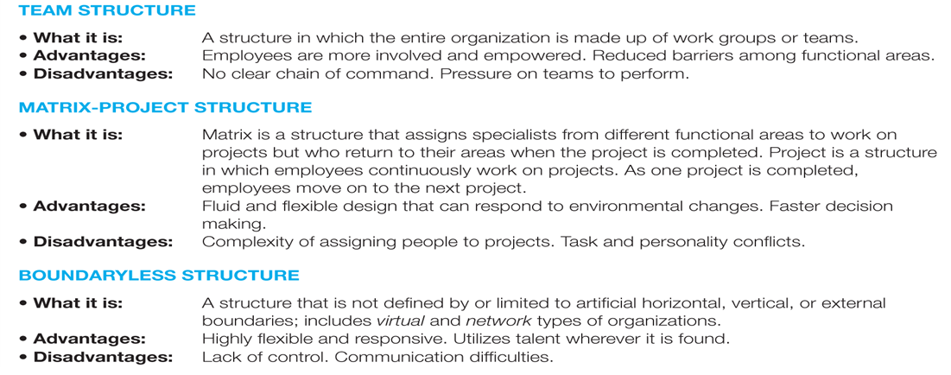
Contemporary Organizational Designs
Reference: Management, 14th Edition by Stephen P. Robbins
Notes:
Because managers find that the traditional designs often aren’t responsive enough to today’s increasingly dynamic and complex environment, they find creative, more organic ways to structure and organize work.
As we see summarized here in Exhibit 6-10:
In team-based structures, the entire organization is made up of work teams that do the organization’s work.
Matrix and project structures assign specialists from different functional departments to work on projects led by a project manager, and
Boundaryless structures are organizations with designs that are not defined by, or limited to, the horizontal, vertical, or external boundaries imposed by a predefined structure.

Slide 9
Flexible Work Arrangements
Telecommuting
Compressed workweeks
Flextime
Job sharing
Contingent workforce
Reference: Management, 14th Edition by Stephen P. Robbins
Notes:
Thanks to technology, work can now be done anywhere and anytime. As organizations adapt their structural designs to these new realities, we see more of them adopting flexible working arrangements that exploit the power of technology and give them the flexibility to deploy employees when and where needed.
Some different types of flexible work arrangements including telecommuting; compressed workweeks, flextime, and job sharing; and contingent workforce.
Telecommuting is a work arrangement in which employees work at home and are linked to the workplace by computer. This arrangement saves the organization overhead and allows employees to save on commuting expenses and time. In this arrangement, managers might be concerned about supervising the productivity of remote employees, keeping employees connected socially, and the security of business information.
Organizations sometimes find they need to restructure work using other flexible work arrangements, such as a compressed workweek in which employees work more hours per day but fewer days per week. The most common arrangement is four 10-hour days.
Another alternative is flextime (also known as flexible work hours), which is a scheduling system in which employees are required to work a specific number of hours a week but are free to vary those hours within certain limits.
Another type of job scheduling is called job sharing, which is the practice of having two or more people split a full-time job. Organizations might offer job sharing to professionals who want to work but don’t want the demands of a full-time position. Many companies use job sharing during economic downturns to avoid employee layoffs.
The labor force has already begun shifting away from traditional full-time jobs toward a contingent workers—temporary, freelance, or contract workers whose employment is contingent upon demand for their services. In today’s economy, many organizations have responded by converting full-time permanent jobs into contingent jobs. It’s predicted that by the end of the next decade the number of contingent employees will grow from 30 percent to about 40 percent of the workforce.
No matter what structural design managers choose for their organizations, the design should help employees do their work in the best, most efficient, and most effective way they can.

Slide 10
THANK YOU

